Slide 1
Threat Feed Analyser
Intelligence Amplified
Transforming raw threat data into actionable insights
Leverages cutting-edge AI for automated analysis
Designed for scale, privacy, and real-time operations

Slide 2






The Deluge of Threat Intelligence
Data Overload
Time Drain
Analysts face 10,000+ new IOCs daily from 100s of feeds
Manual correlation leads to 60% time spent on data sifting
Alert Fatigue
Static Insights
75% of critical alerts missed in noisy environments
Static reports lack context, real-time applicability
The sheer volume and complexity of cyber threats overwhelm human analysts, leading to missed threats and inefficient operations.

Slide 3
Threat Feed Analyser:
An AI-Powered Solution
Automates parsing, normalization, and contextualization of threat feeds
Identifies critical threats, prioritizes based on organizational context
Utilizes local LLM (Ollama) for summary and risk scoring
Provides actionable intelligence, reducing investigation time by 70%

Slide 4







System Architecture:
Secure & Scalable
Ingestion Module
Processing Engine
Local LLM Integration
Ingests STIX/TAXII, OSINT, and proprietary feeds
Python backend, applies analysis algorithms
Ollama for secure, on-premise NLP processing
Data Lake
Front-End
MongoDB Atlas for scalable, flexible storage
Dash/Plotly for interactive data visualization

Slide 5

Advanced Analysis Algorithms
IoC Clustering
Anomaly Detection
Risk Scoring
Groups related indicators by threat actor/campaign
Flags unusual patterns in network traffic/logs
Assigns criticality based on LLM analysis and internal rules
Graph Database
Threat Categorization
Correlates disparate IOCs via network graphs
Classifies threats (e.g., Ransomware, APT) with 95% accuracy

Slide 6
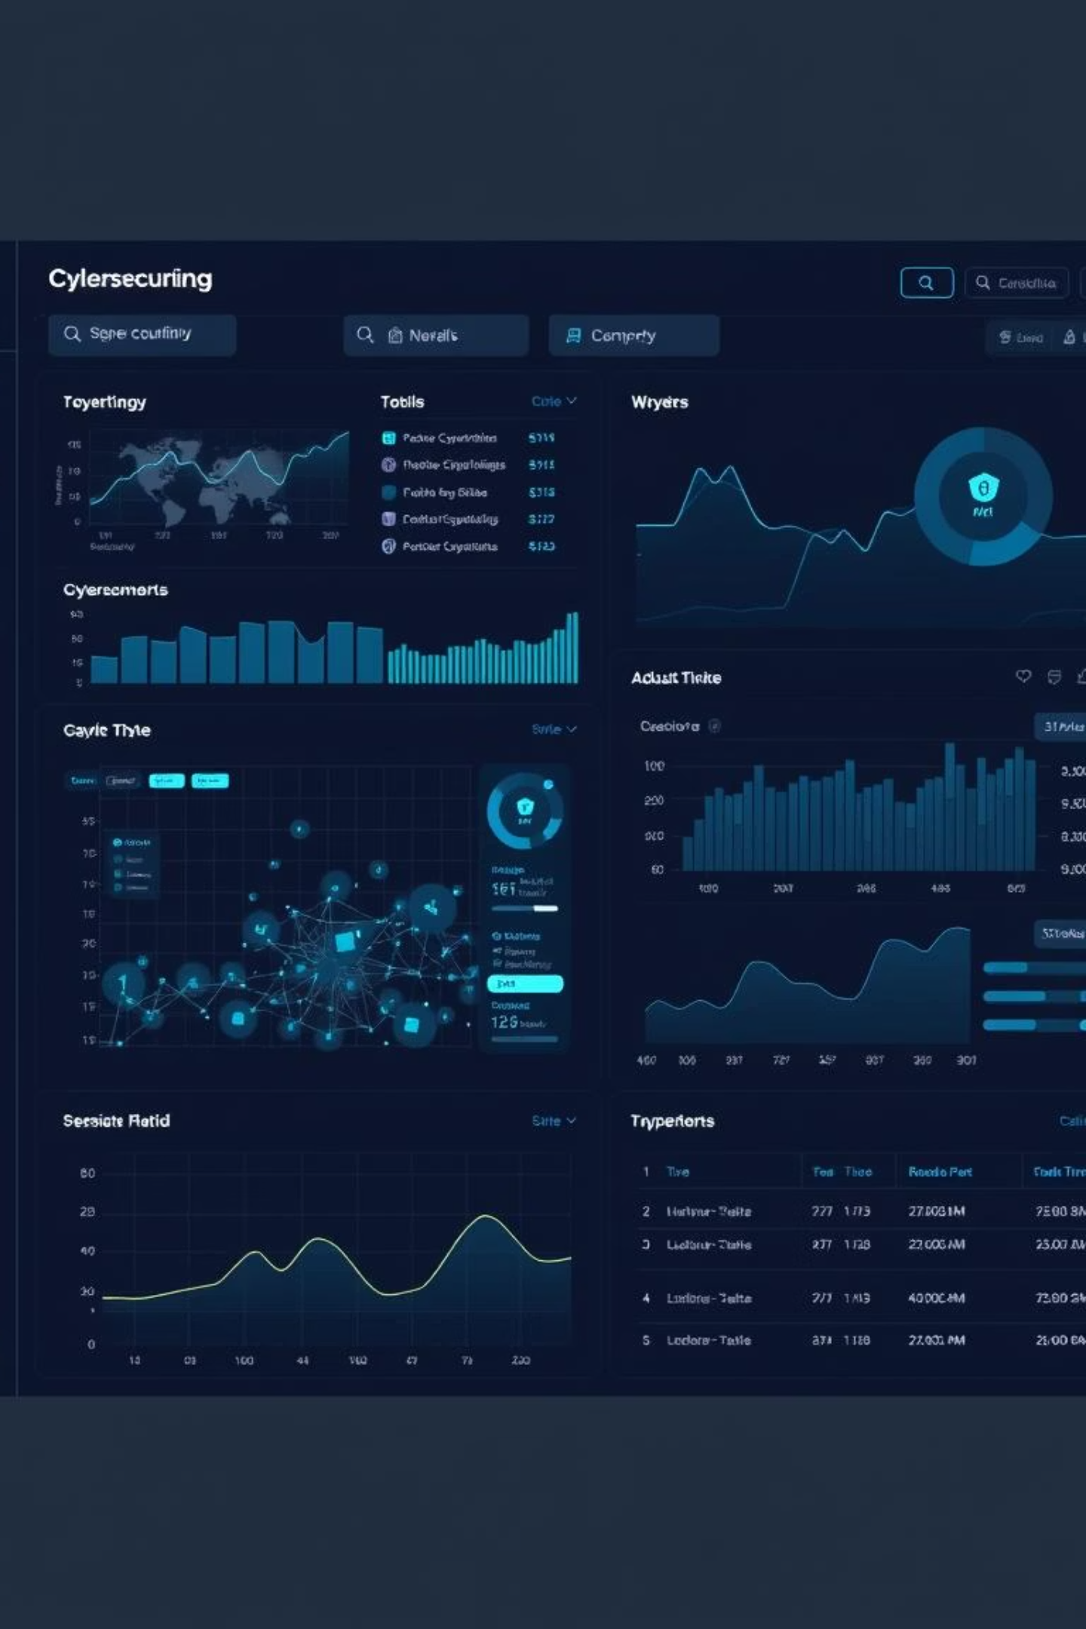
Threat Feed Analyser
Intuitive Dashboard UI & UX
Modern dark theme with cyber accents and data visualization
Interactive dashboards for real-time threat landscapes
Customizable widgets: threat maps, timeline analysis, IoC tables
Responsive design via Bootstrap and custom CSS for all devices
Direct drill-down from high-level summaries to raw data

Slide 7
Impact & Demo Highlights
4x
50%
—
—
Faster Response
Improved Detection
Real-time Views
Narrative Summaries
Reduces average incident response time (from 2 hours to 30 mins)
Increases critical threat detection rate
Key dashboard views showcasing live data analysis
Natural language summaries for complex threat narratives

Slide 8

Core Tech Stack & Future Vision
Core Components
Future Vision
Python: Primary language for backend logic and data processing
Integration with SOAR platforms
Custom alert generation
Dash & Plotly: For rich, interactive, real-time data visualizations
API access for third-party systems
MongoDB Atlas: Cloud-native NoSQL database for flexible data storage
Enhanced machine learning models for predictive analysis
Ollama: Local LLM integration for privacy-preserving AI analysis
Bootstrap & Custom CSS: For a responsive, futuristic user interface

Slide 9

Thank You
Questions & Discussion
Threat Feed Analyser: Empowering the next generation of cyber defense.

